Slide 1

Time-Wasters on
Social Media
page 01

Slide 2

INTRODUCTION
The "Time-Wasters on Social Media" dataset analyzes social media habits across demographic groups focusing on psychological factors like productivity loss and addiction. It offers insights into behavioral patterns, usage reasons, and social media's impact on daily life.
page 02

Slide 3








OBJECTIVES
  Identify Key Motives for Social Media Usage.
  Explore Content Preferences Across Genders.
  Provide Insights for Targeted Marketing
page 03

Slide 4

ANALYSIS
page 04

Slide 5
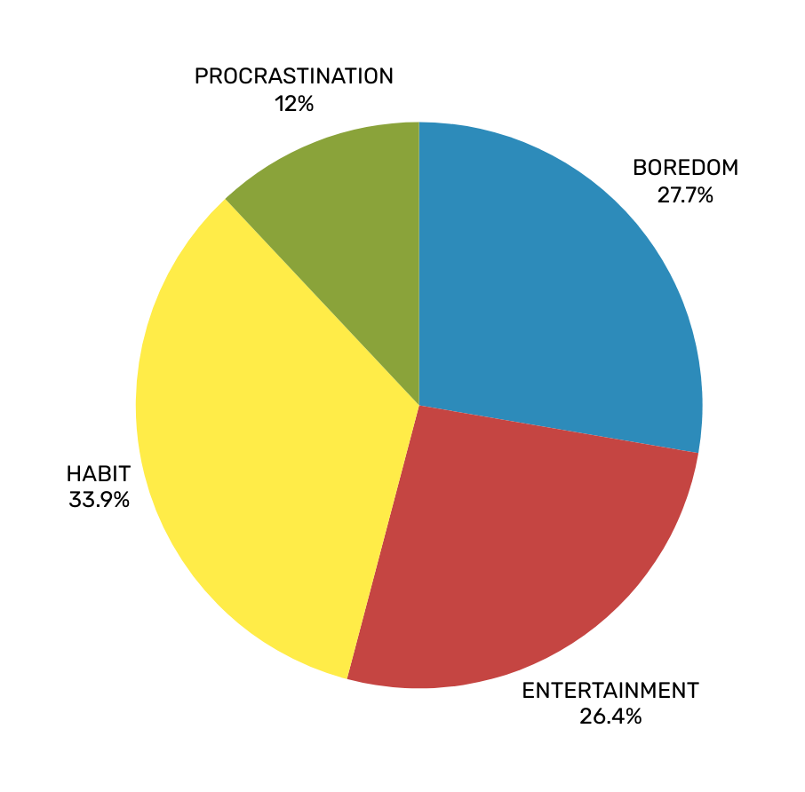

Reasons for using social media
page 05

Slide 6
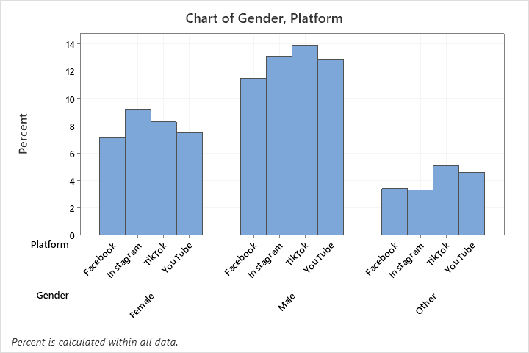


Most popular social media platforms among the genders
page 06

Slide 7
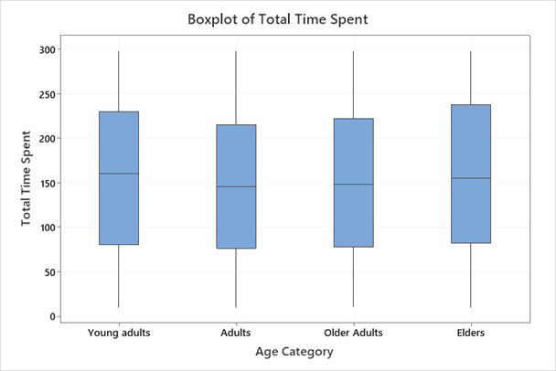


How much do you spend time on social media?
page 07

Slide 8
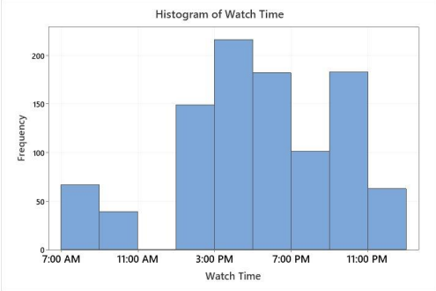

How frequently do people going through social media in daily life?
page 08

Slide 9
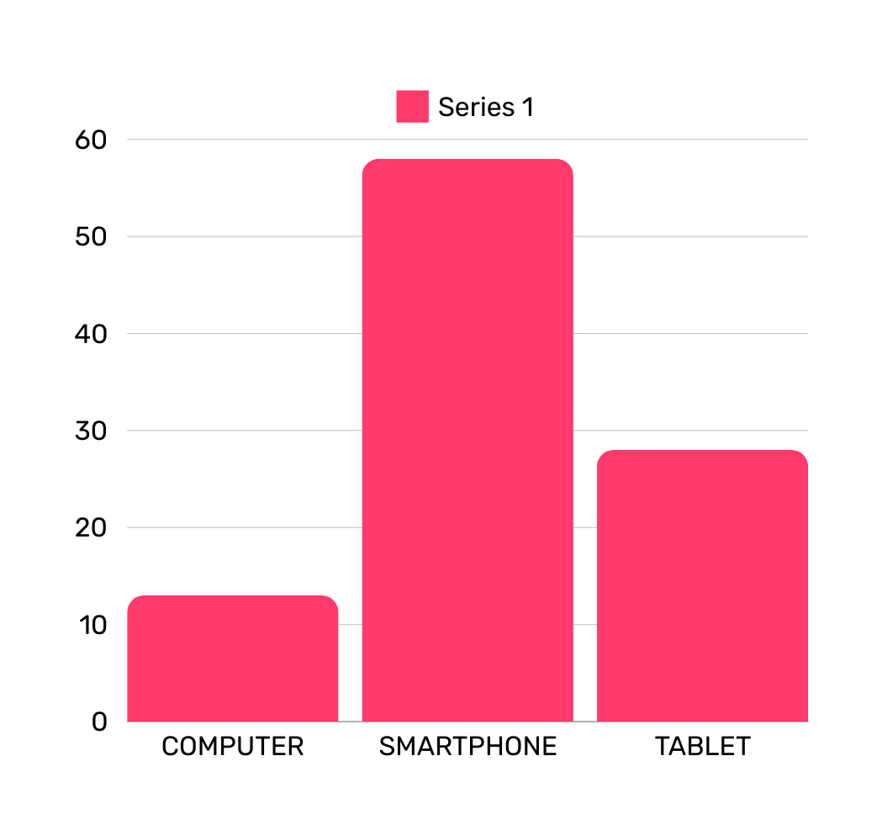



Study of the Type of Device using when engage in social media
page 09

Slide 10
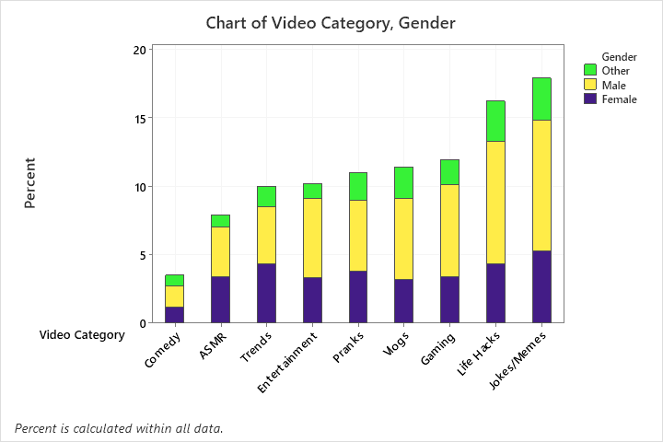

Video category preferences
page 10

Slide 11


What did we find?
Many users engage in social media as a routine, with habit being the main reason for usage rather than content interest.
Most users access social media through smartphones, contributing to habitual usage.
A large portion of users exhibit addictive tendencies, significantly impacting productivity and daily routines.
page 11

Slide 12

page 12

Slide 13

Group 20
Ashani H. A. P. s17240
Hafsa M. H. F. s17241
Handapangoda H. S. s17242
Hemachandra K. D. S. S. N. s17244
Jayasundara S. D. s17245
page 13

